Slide 1
INCOME MAXIMIZER
The Income Maximizer is designed to help you as a distributor earn extra cash with each step you take on the road to growing your team and your long-term residual income.
HOW IT WORKS

Slide 2
Here’s How it Works
This bonus is based off of the enrollment tree ONLY.
4 personally sponsored people with a minimum of 100 PV/month = $50 USD BONUS
2 of those 4, have 4 personally sponsored people with a minimum of 100 PV/month = $500 USD BONUS
4 of those 8, have 4 personally sponsored people with a minimum of 100 PV/month = $1,500 USD BONUS

Slide 3
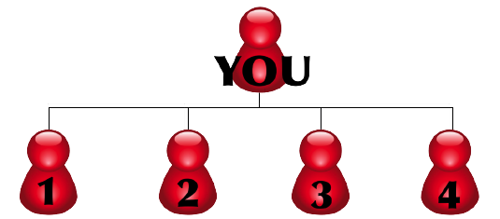
LEVEL 1
100 PV
$50 =
USD
100 PV
100 PV
100 PV
100 PV
4 personally sponsored people with a minimum of 100 PV/month = $50 USD BONUS

Slide 4
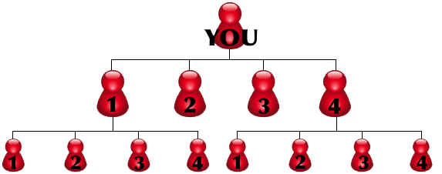
LEVEL 2
100 PV
$500 =
USD
100 PV
100 PV
100 PV
100 PV
100 PV
100 PV
100 PV
100 PV
100 PV
100 PV
100 PV
100 PV
2 of those 4, have 4 personally sponsored people with a minimum of 100 PV/month = $500 USD BONUS

Slide 5
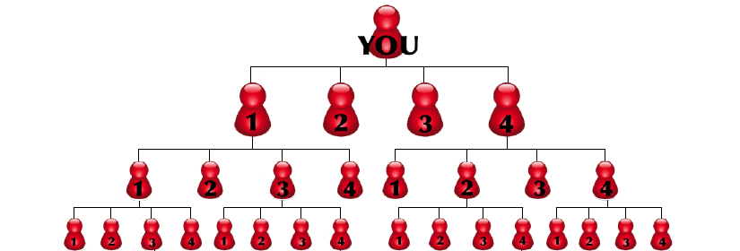
LEVEL 3
$1,500 =
USD
4 of those 8, have 4 personally sponsored people with a minimum of 100 PV/month = $1,500 USD BONUS

Slide 6
Key Rules
The bonus is per level not cumulative.
– For example: If you get 4, that is $50 USD
– If you then have 2, that get 4, that is $500 USD
Always based off of 100 PV minimum of PERSONAL PURCHASES (customer volume does NOT count).
The Income Maximizer is an alternative to the comp plan, NOT an addition to the comp plan. Each month, distributors will be paid either the Expressway amount or the comp plan commission, whichever is GREATER.
If you are counting Starter Kit volume, the person must also be committed to and signed up for a 100 PV minimum AutoShip to count.
You personally must have 100 PV minimum to earn the bonus.
To earn the Maximizer bonus you must earn it in 1 commission period.
You cannot participate in this bonus if you have reached the rank of Emerald Managing Director or higher.

